Slide 1
S.T.R.O.N.G.
Let’s Serve A Country Mile

Slide 2
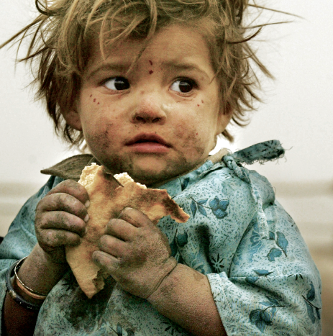
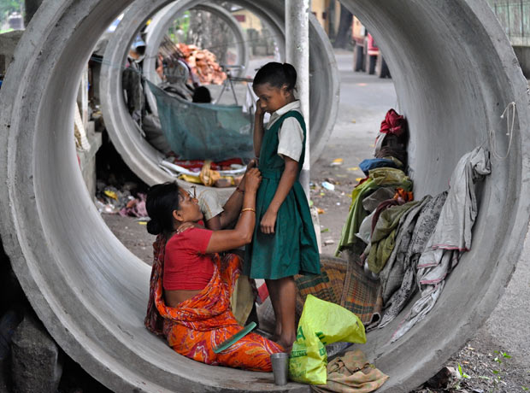
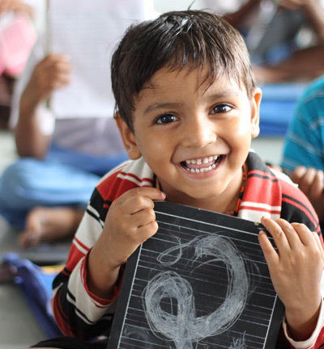
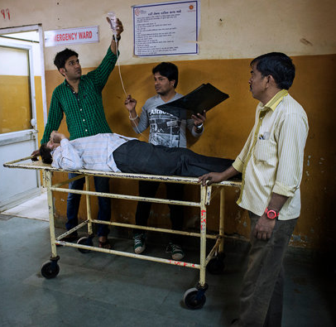
Problem:
Food Shelter
Education Health

Slide 3


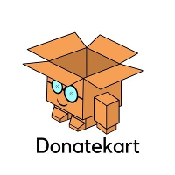
Our inspiration:
Robin Hood Army Share The Meal App DonateKart

Slide 4
S.T.R.O.N.G. Project:
What is S.T.R.O.N.G.?
S.T.R.O.N.G. is a platform built for each and every person of the society.
In a way it’s an online community for the people who wants to help, who wants to join hands for the upbringing of underprivileged people.
How S.T.R.O.N.G. works?
S.T.R.O.N.G.’s work is to battle against 3 major issues affecting the society.
Hunger
Illiteracy
Health

Slide 5
S.T.R.O.N.G. Project:
Hunger:
1. One user posts about the food requirements of needy people, other users can help to fulfill those requirements.
2. One user (Organization) posts about food preparation for needy people, other users can join them in distribution.
Illiteracy:
One user (Organization) posts about educational activities
i.e., Education session, fun learning, books distribution at a cluster,
other interested users can join the activity.
Health:
1. A user posts about any health emergency of underprivileged people and any local organization gets notified about it.
2. One user (Organization) arranges Health checkup camps, blood donation camps etc., other users voluntarily joins the activity.

Slide 6
What Makes S.T.R.O.N.G. Unique:
User authentication for fair use.
“Zero-Money” approach for charity.
Community including organizations like NGOs & Businesses for fighting different issues.
Storing the locations of clusters for future use.
100% transparency.
Spam feature to detect and avoid false needs.

Slide 7
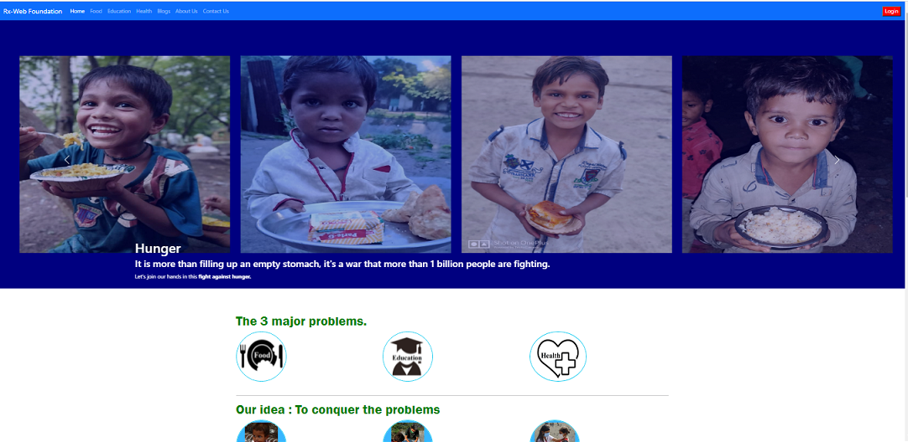
Overview of S.T.R.O.N.G. :
1. Home page (i)

Slide 8
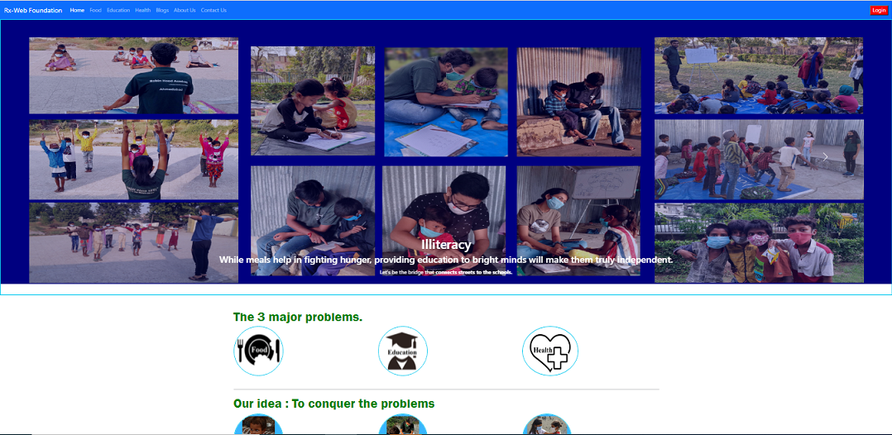
Overview of S.T.R.O.N.G. :
2. Home page (ii)

Slide 9
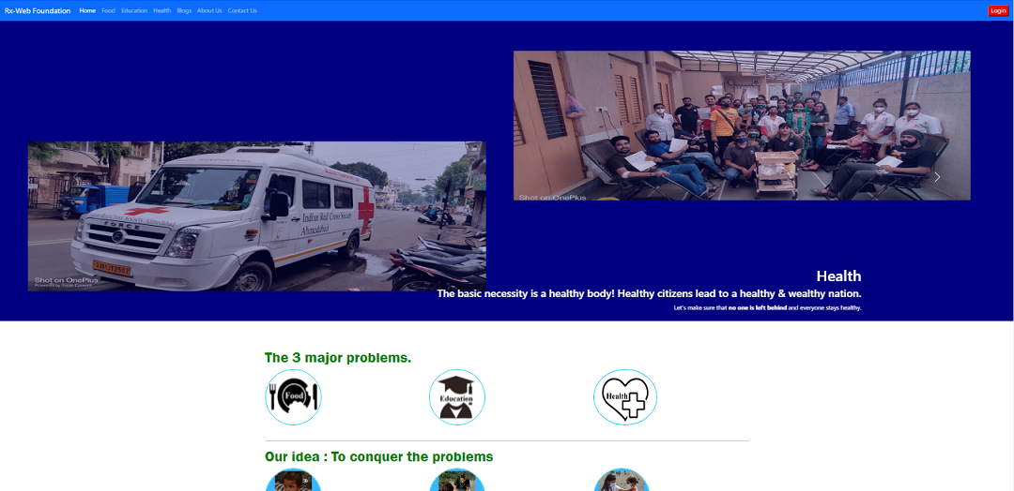
Overview of S.T.R.O.N.G. :
3. Home page (iii)

Slide 10
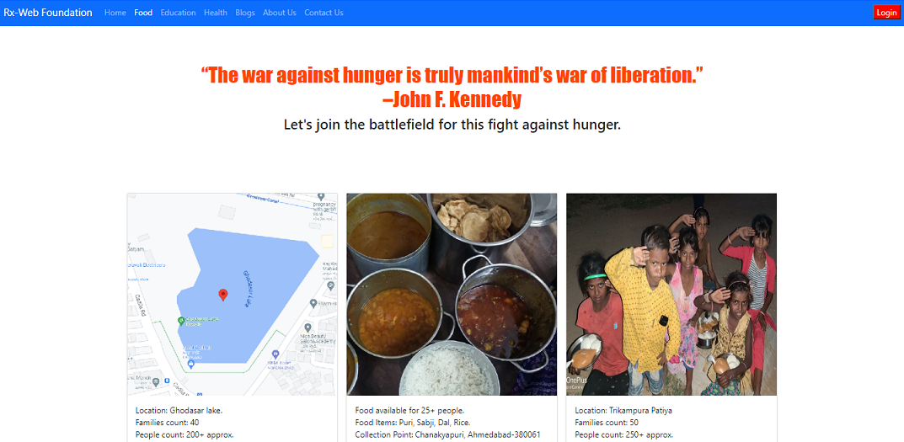
Overview of S.T.R.O.N.G. :
4. Food page

Slide 11
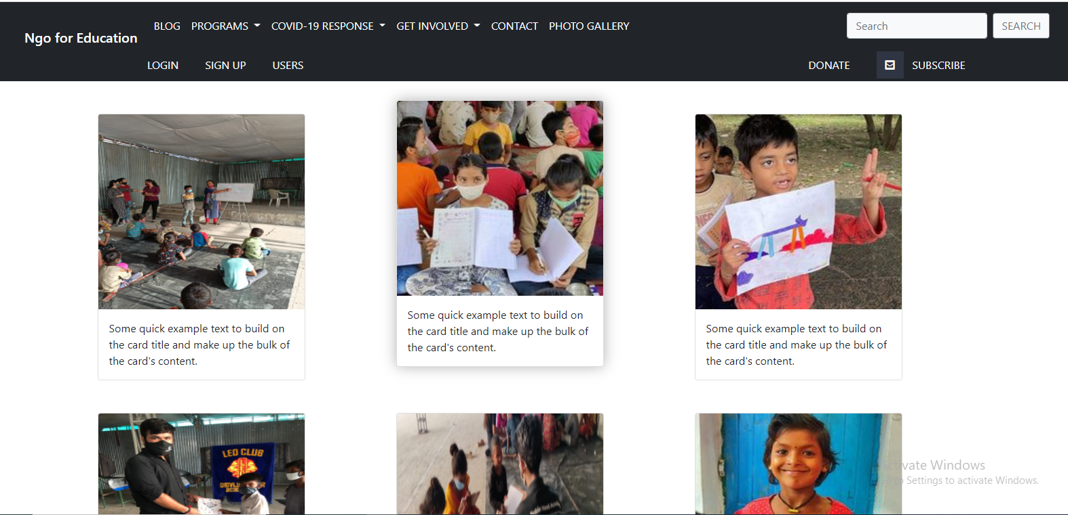
Overview of S.T.R.O.N.G. :
5. Education page

Slide 12
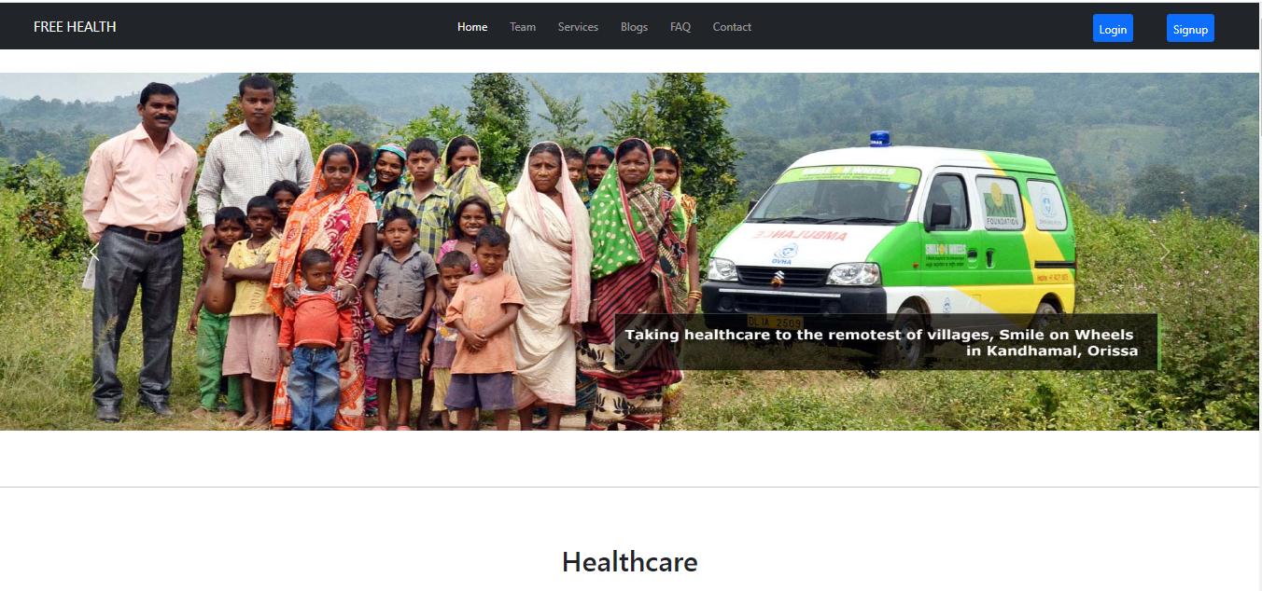
Overview of S.T.R.O.N.G. :
6. Health page

Slide 13
Target Audience:
Individuals willing to help,
NGOs,
Businesses,
Government organizations.

Slide 14
Future scope of S.T.R.O.N.G.:
In the first 3 months of the website launch our target is to reach across the state with the help of users.
In one year our target is to reach across the country.
Our target is to build a strong community worldwide who can join the hands to help the needy ones.

Slide 15
Team S.T.R.O.N.G.:
1. Dhruvit Diyora
2. Piyushsingh Thakur
3. Preet Gandhi
4. Shubh Patel

Slide 16
Thank you!

